Slide 1
IPT #10 - Hail
University of Ljubljana - Slovenia

Slide 2
Official problem statement
Extract as much information as possible about the shape and dimensions of a metal container from the sound produced when dropping small objects (such as peas) into it.

Slide 3
Introduction
-“Can we hear the shape of a drum?”
-Eigenfrequencies give the information
-Eigenvalues of the Laplacian with appropriate boundary conditions
-Deviations from the mathematical question

Slide 4
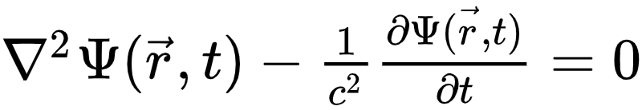
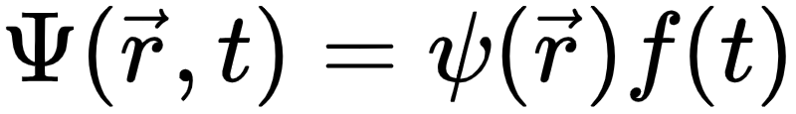
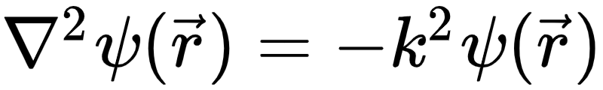
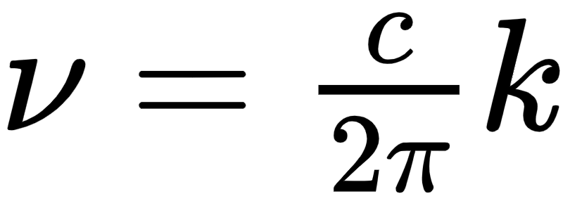
Theoretical description
To find the eigenfrequencies solve the wave equation of the volume oscillations of the air
with the stationary wave guess , giving

Slide 5
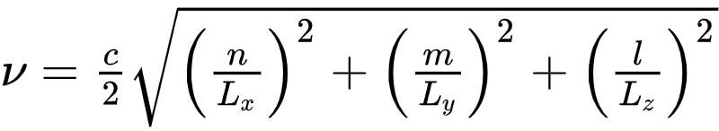
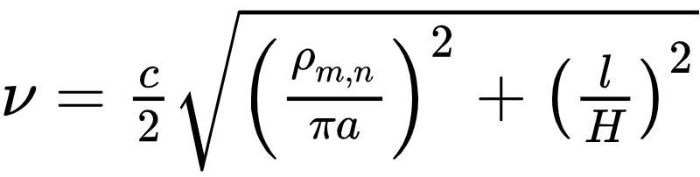
Theoretical description
-Special cases:
Rectangular geometry:
Cylindrical geometry:

Slide 6
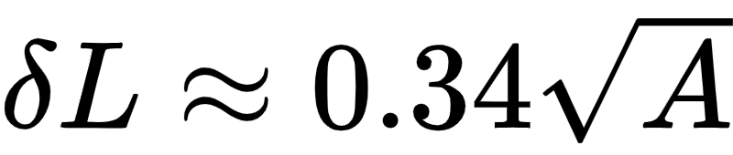
End corrections
The Neumann condition for open ends is only approximate
If the perpendicular dimensions are small compared to the open one we have the empirical formula

Slide 7
Complications
-Analytic solutions impossible for general geometry
-Can’t use side and bottom oscillations (Kirchhoff-Love plates)
-Microphone can only pick up first few peaks

Slide 8
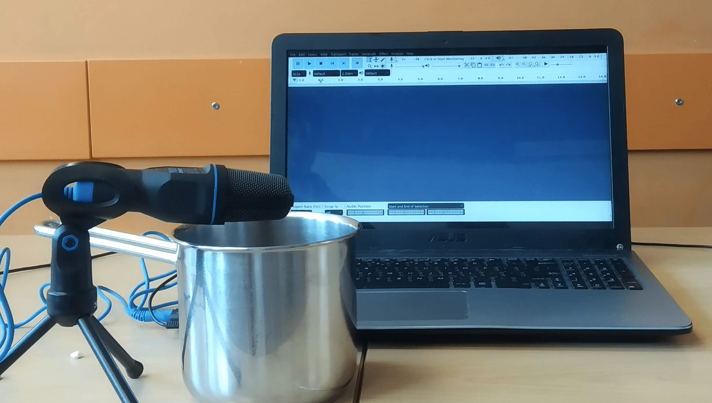
Experimental setup

Slide 9
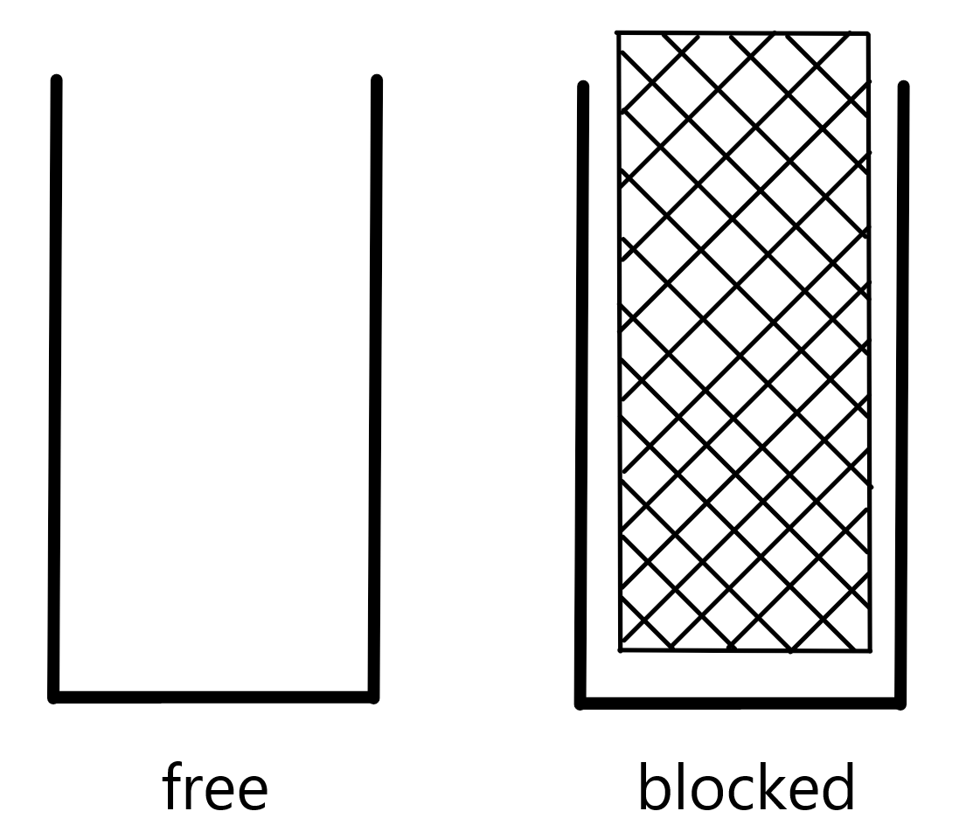
Measurements
-Dropping small stones into the container
-Two ways of measuring: volume free and volume blocked
-Microphone: Trust All-round USB Mico microphone [<7000 Hz]
-Spectrum analyzed with Audacity [ver. 2.2.1] {Algorithm: Spectrum, Function: Hamming window, Size: 8192}

Slide 10
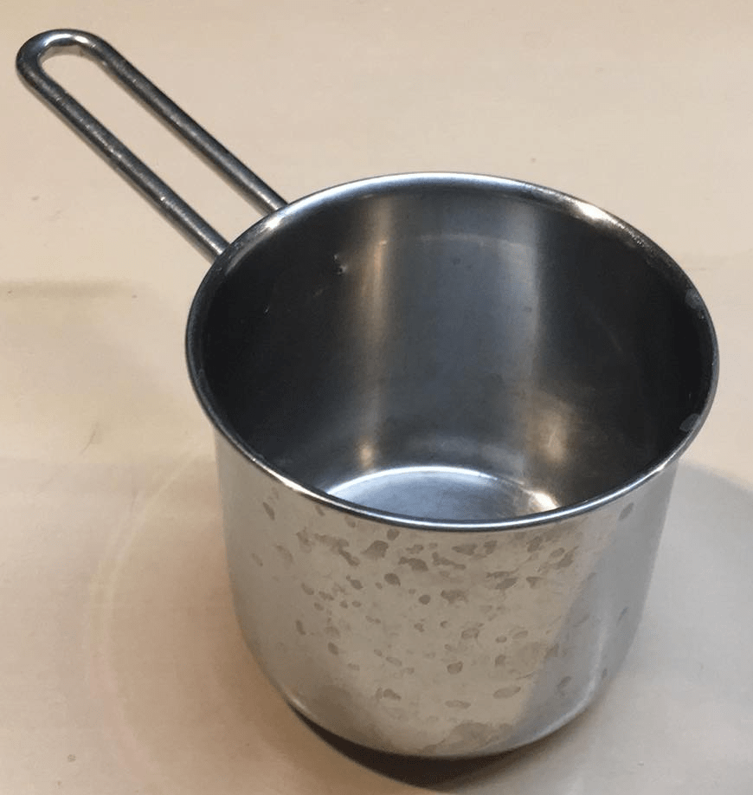
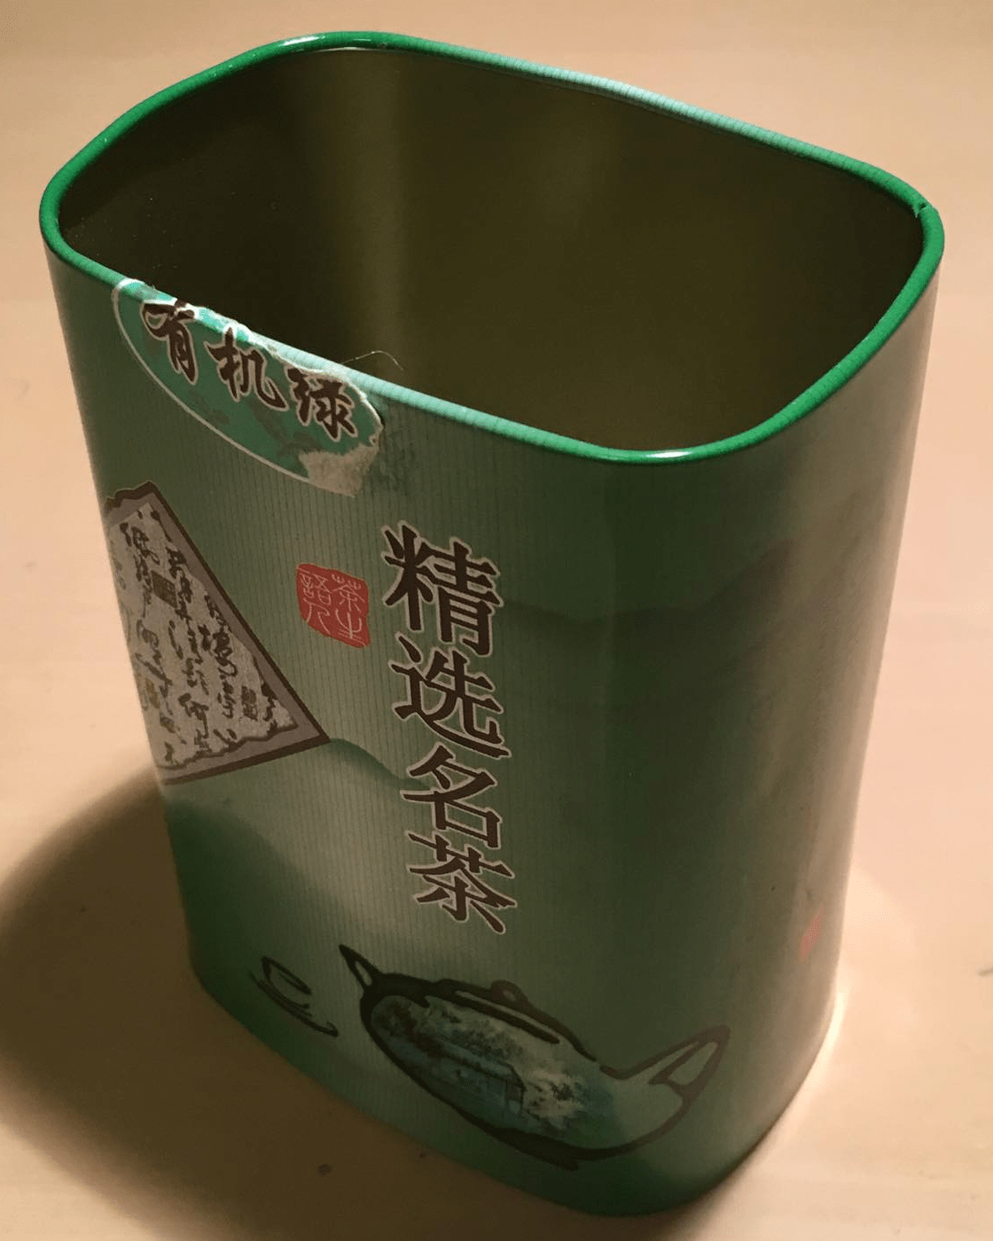
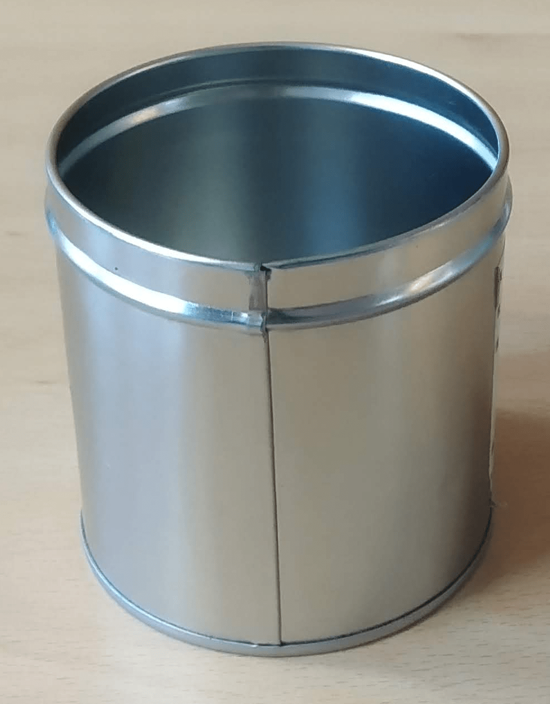
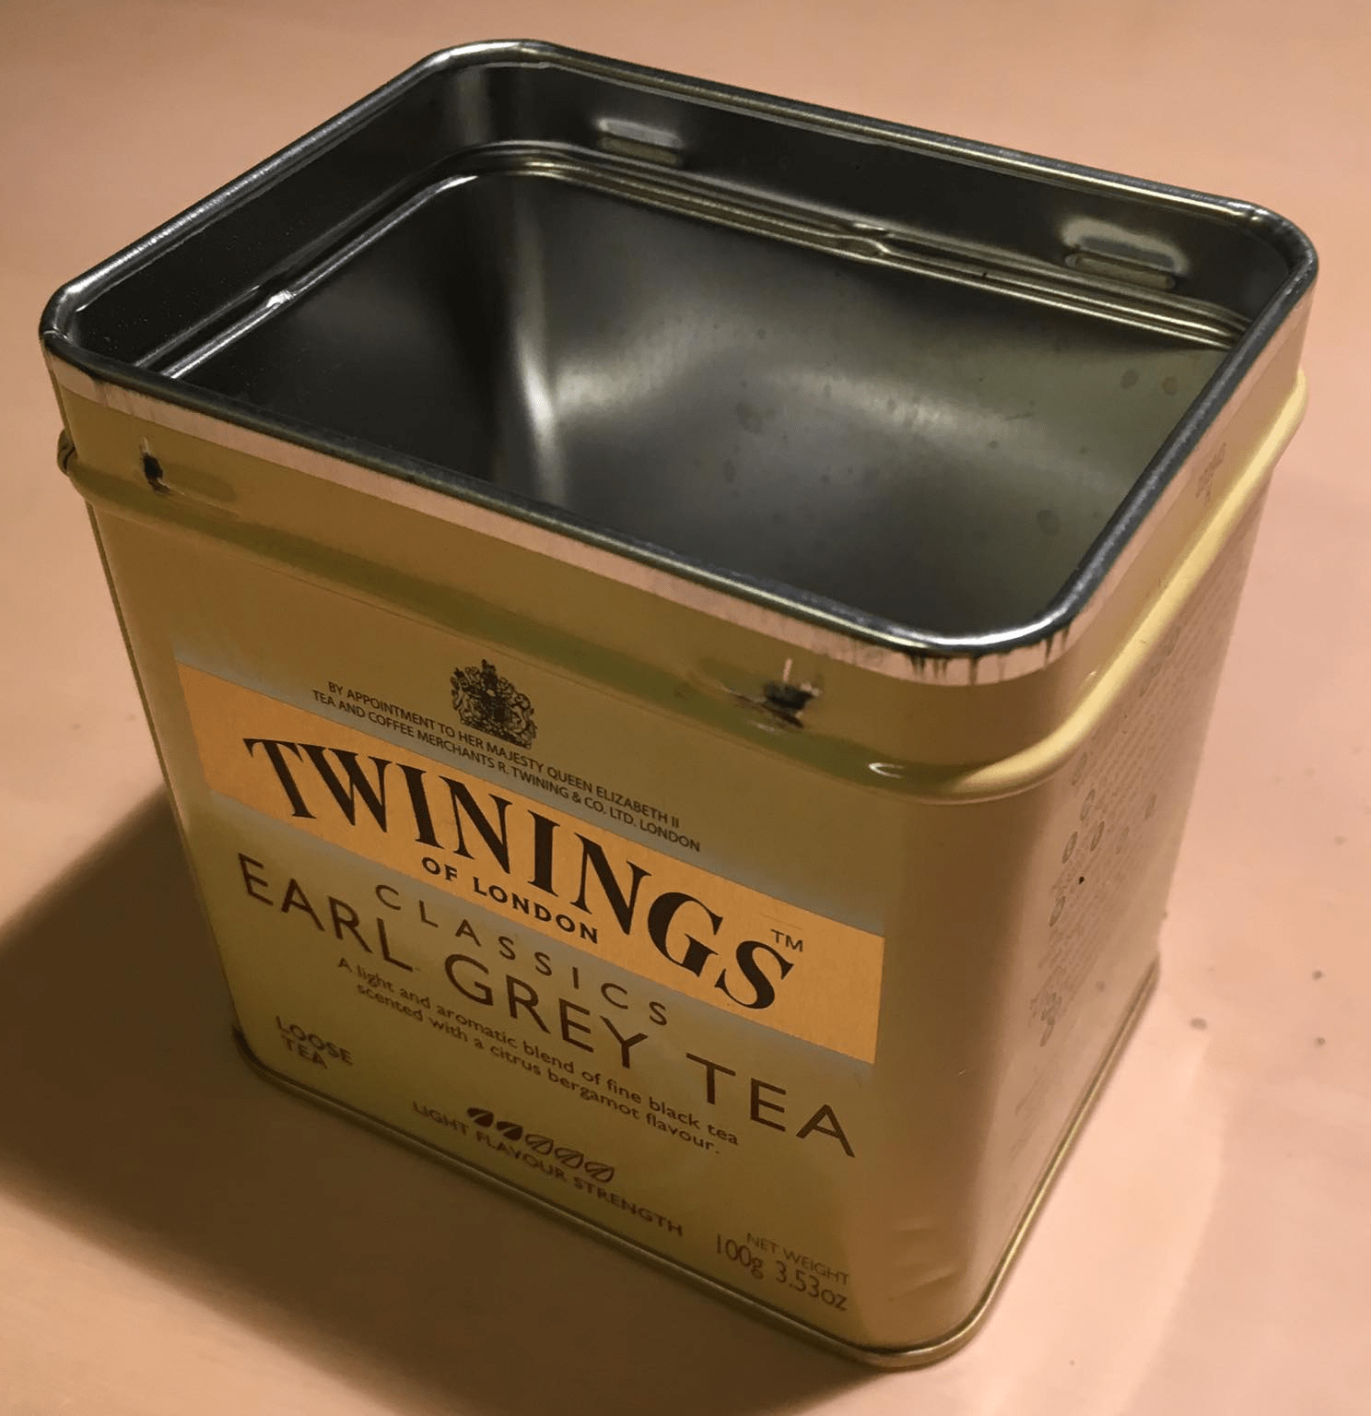
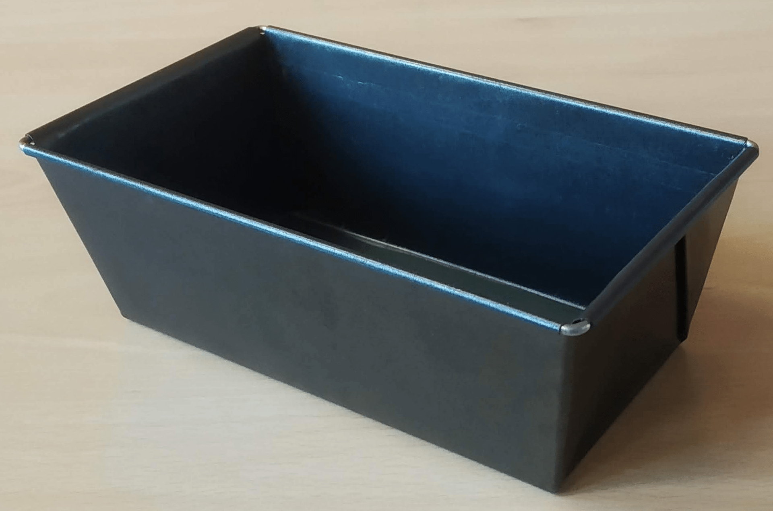
Measurements
-Containers used:
Cylindrical pot (H = 11.0cm, R = 6.0cm)
Cylindrical tea box (H = 8.0cm, R=3.0cm)
Rectangular cake pan (L_{x}= 16cm, L_{y}= 8.0cm, L_{z}=7.0cm)
Two blind test containers
(1)
(3)
(2)
(4)
(4)

Slide 11
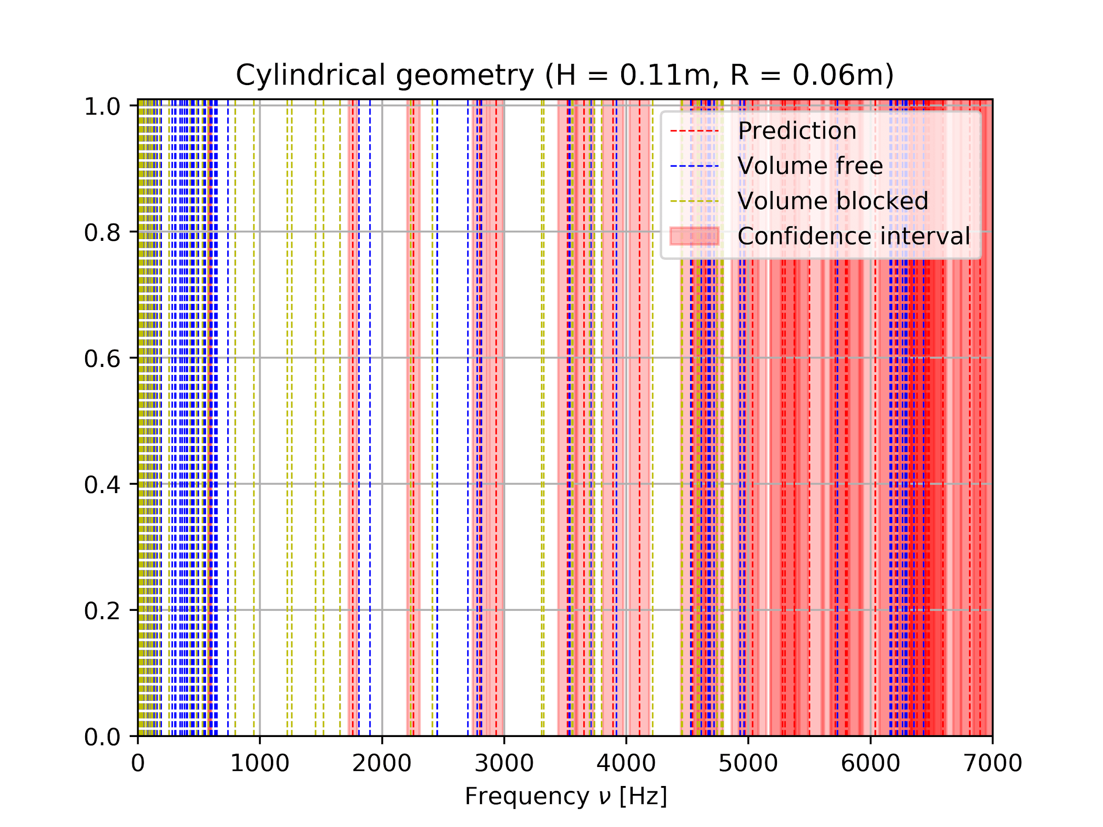
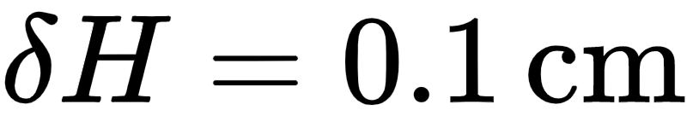
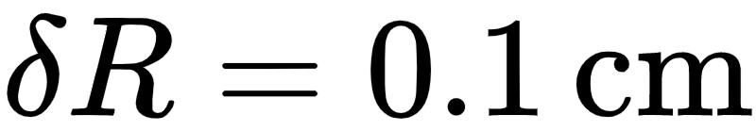
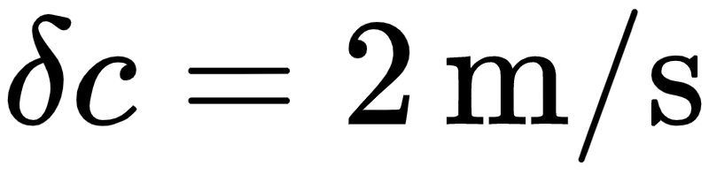
Error estimates:

Slide 12
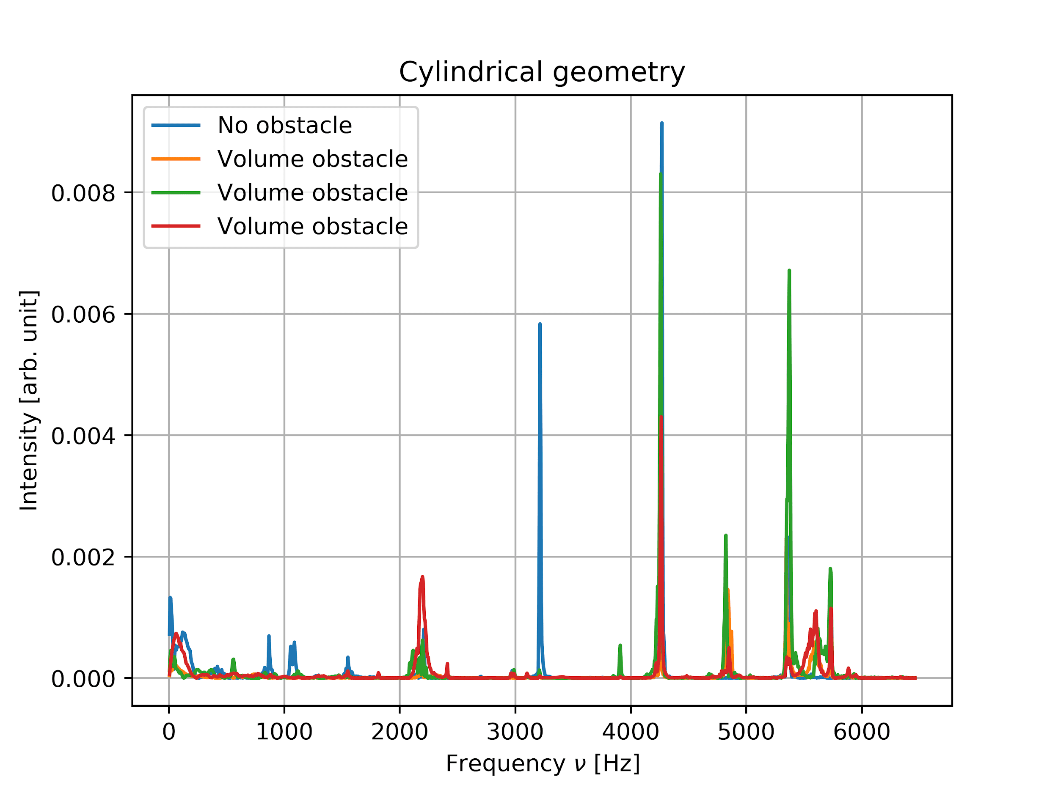
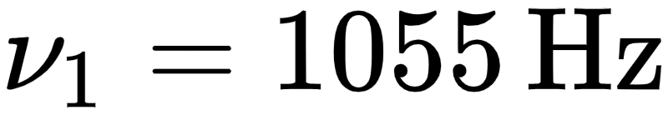
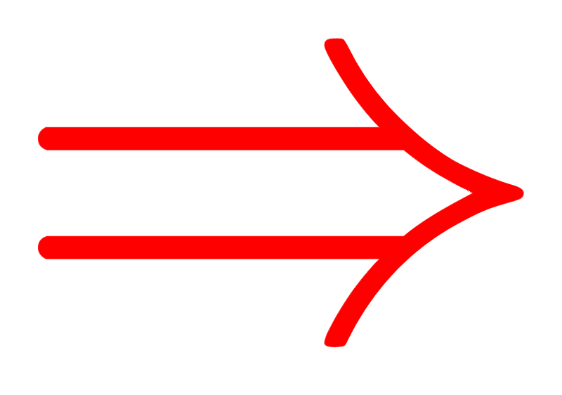
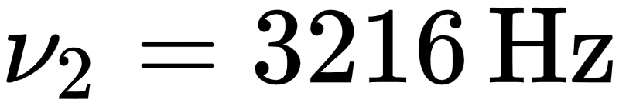


Peaks at:

Slide 13
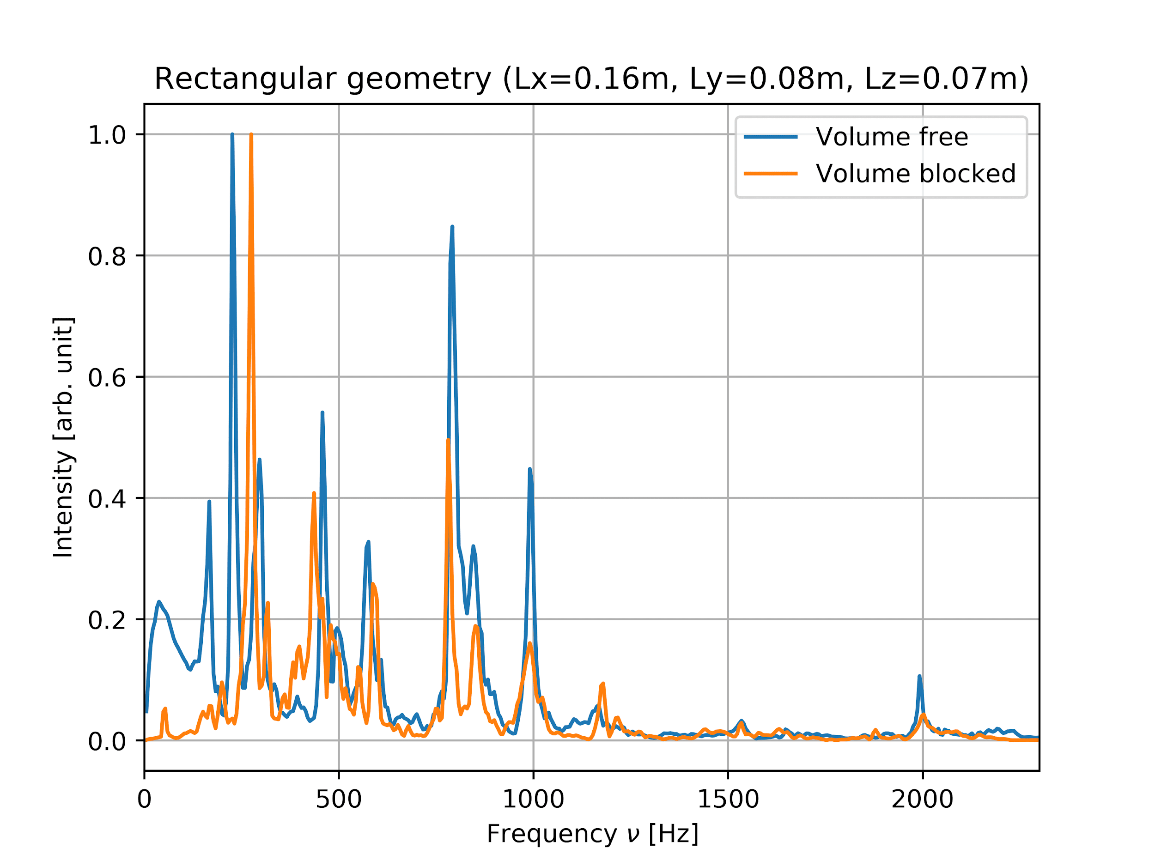
-Signal was noisier
-Blocking wasn’t successful
-Opening was too large

Slide 14
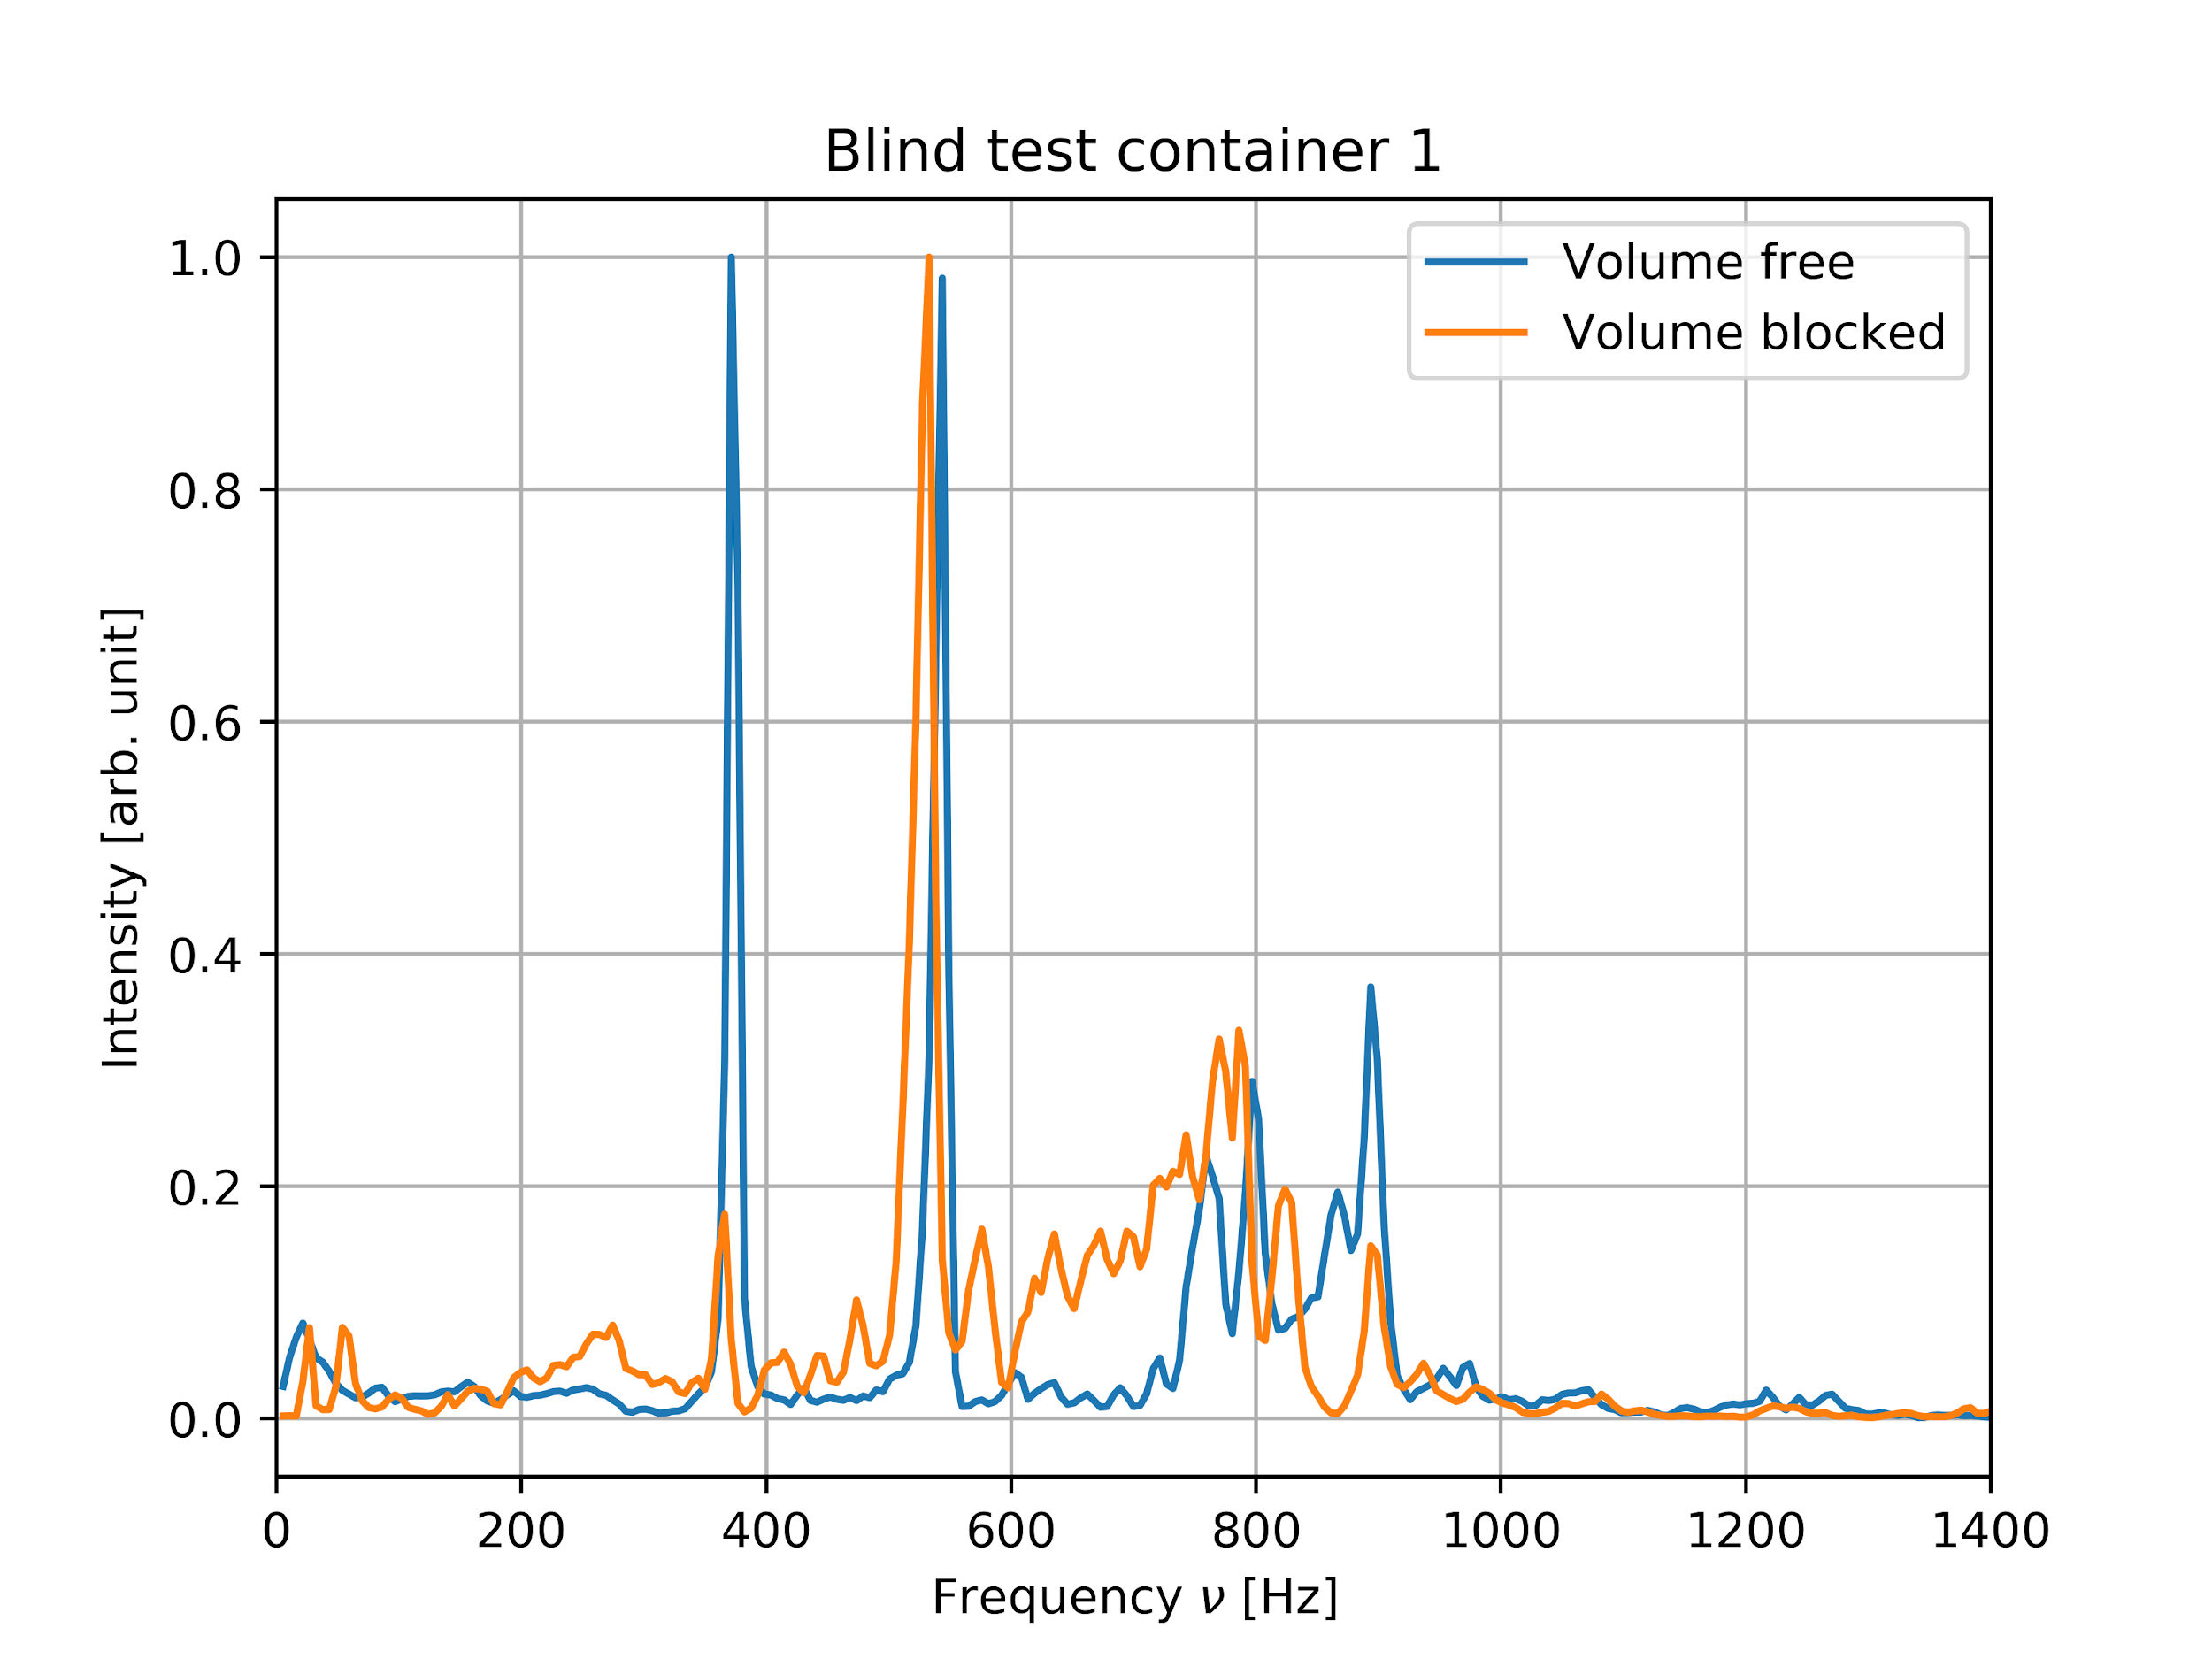
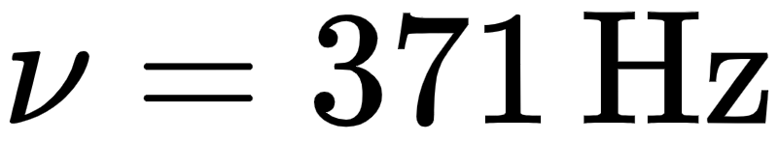
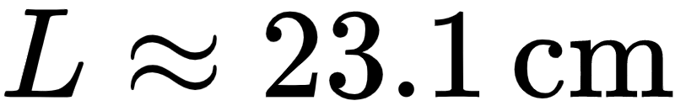
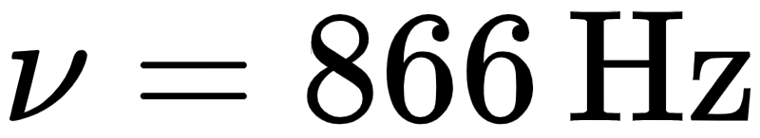
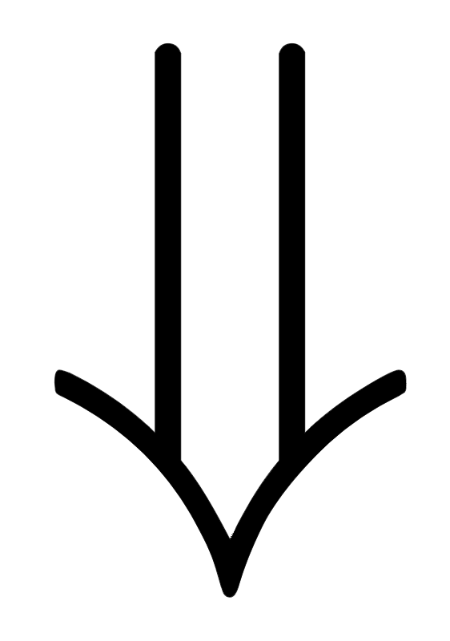
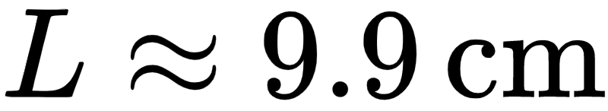
First guess at peak:
gave
At second glance:

Slide 15
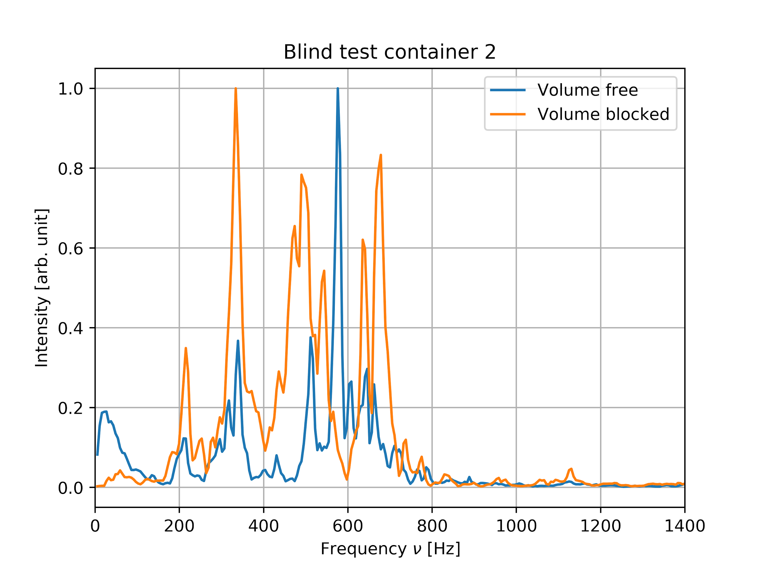
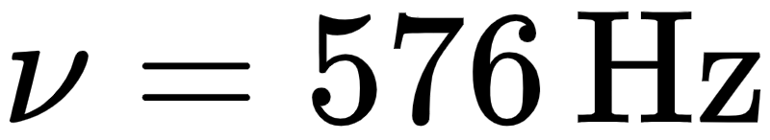
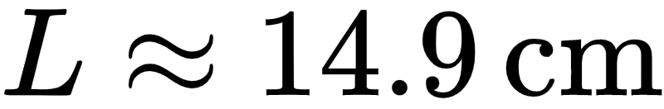
Peak:

Slide 16
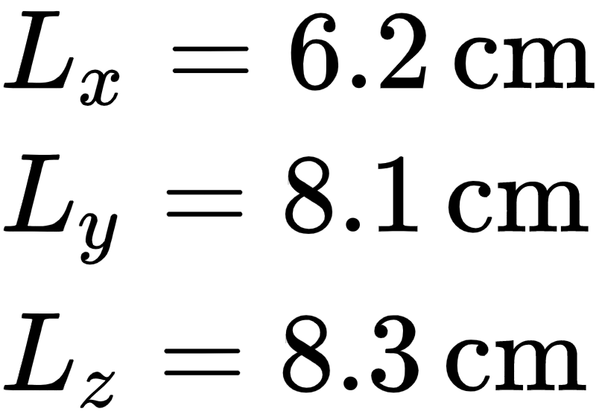
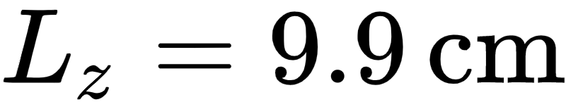
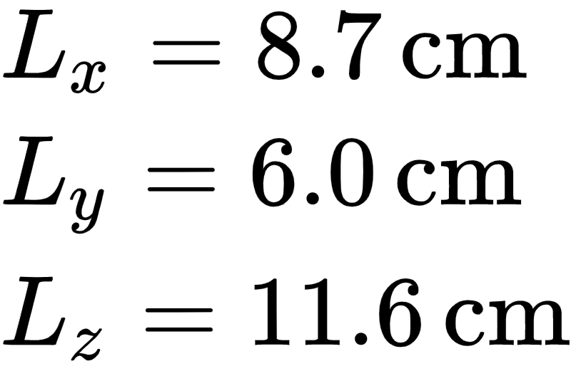
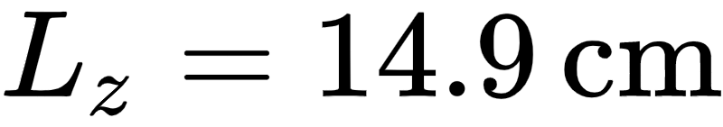
Blind test 1:
Actual size: From spectra:
(1)
Blind test 2:
Actual size: From spectra:
(2)

Slide 17
Conclusions and Discussion
-Mathematical solution has been known
-Physically, there are important complications
-Usual outcome: can’t find geometry, can approximate biggest side
-Better formula for end corrections
-Larger span of frequencies
-Better way to compare peaks

Slide 18
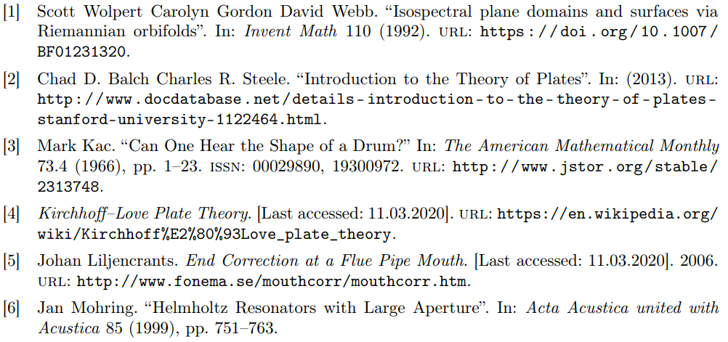
Bibliography

